Slide 1


Meet the teacher Year 4
Autumn 2025

Slide 2
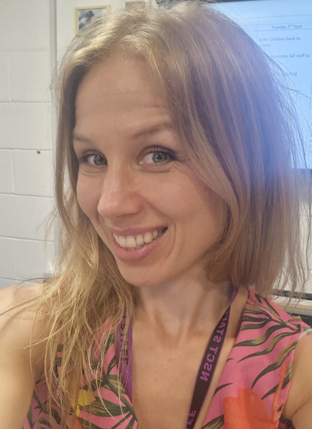
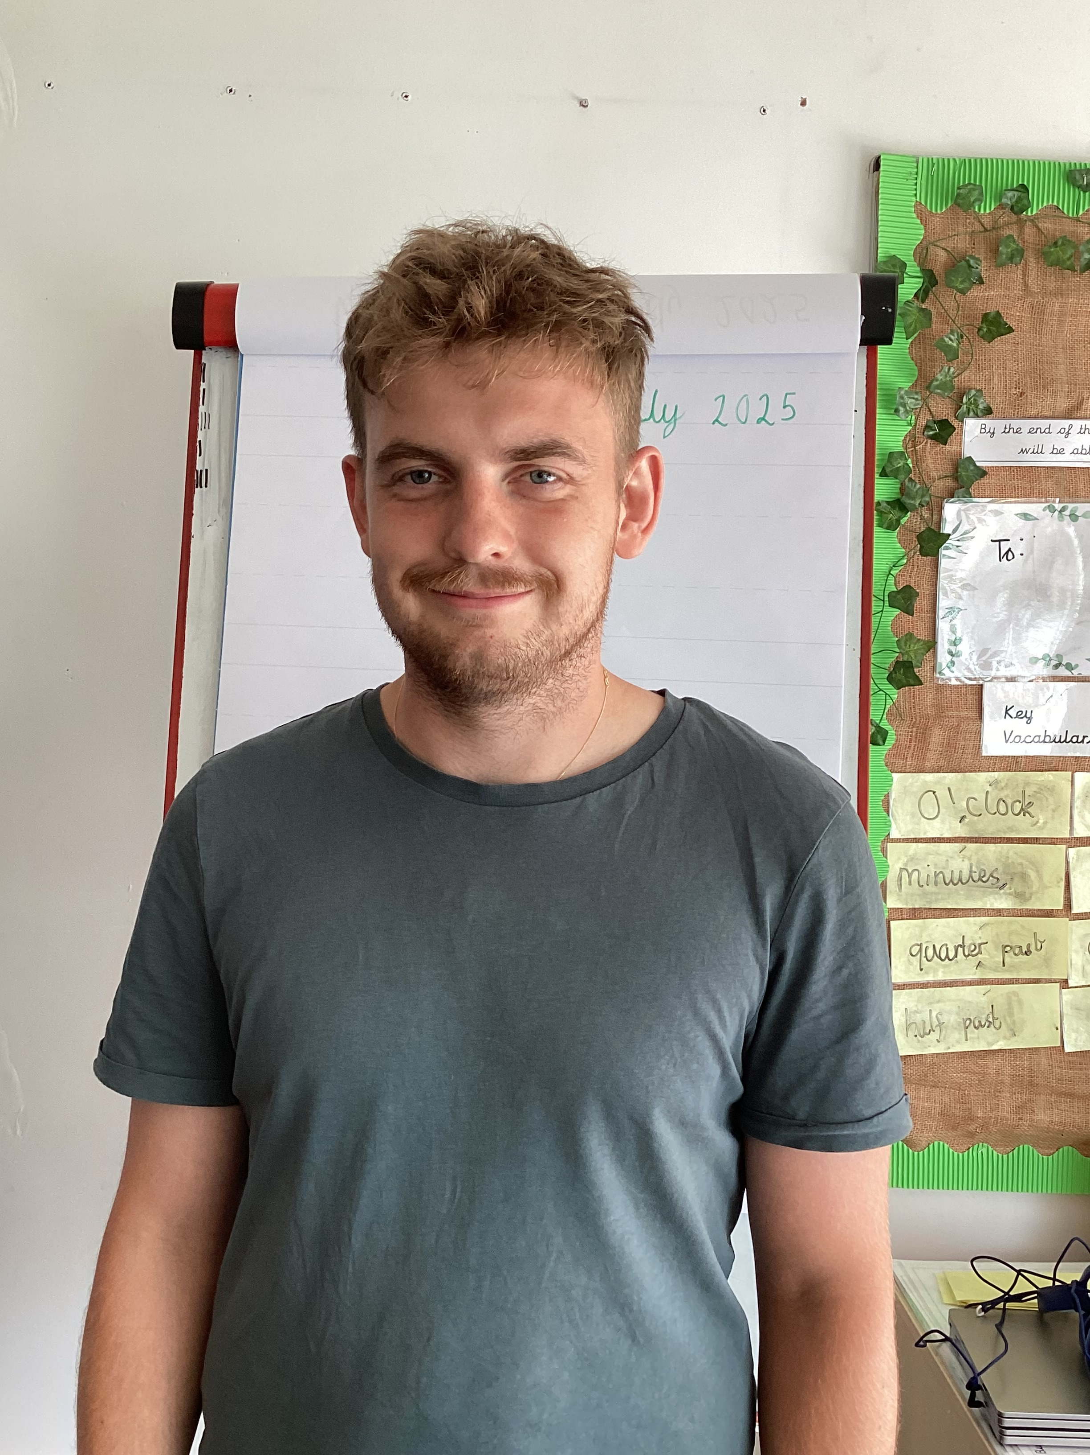
Meet the team
Mrs. Ubor
Class Teacher
Maths Lead
Mr. Hollas
Teaching Assistant

Slide 3
Our School Values
KINDNESS, RESPECT, RESILIENCE & BRAVERY
What underpins our curriculum (school drivers)
To be a Force for Positive Change
We want out children to be the change they want to see in the world
Reading
Reading is the gateway to all learning.

Slide 4







Our Behaviour Expectations
Marbles
Listening and Learning
Celebration
Attendance & Punctuality

Slide 5
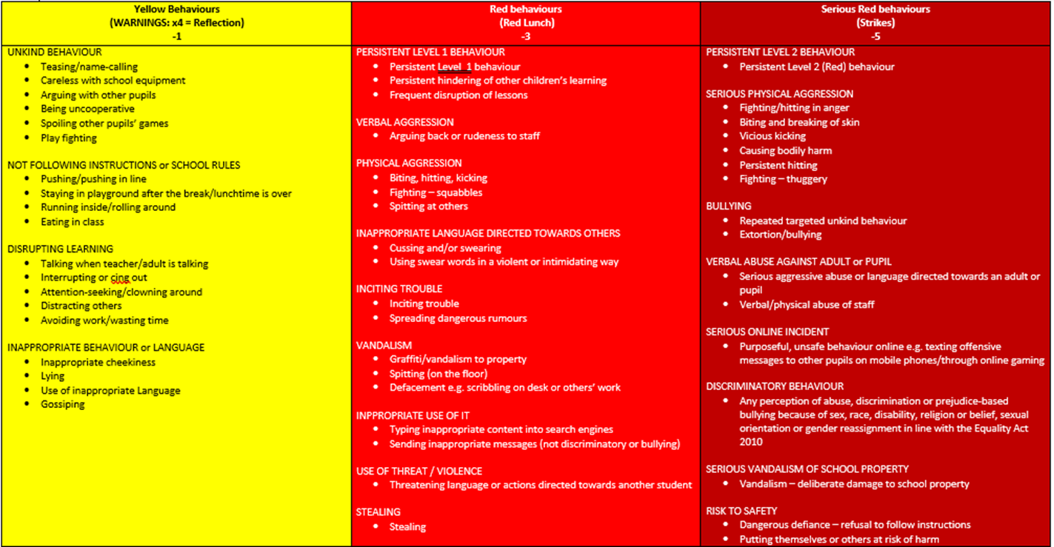


Behaviour

Slide 6


Notes:
Here are the Zones – we will introduce them to you using the lesson you will give your class

Slide 7

Developing pupil voice

Slide 8

Attendance & Punctuality
At a minimum we expect children to be in school for 96% of the time. This can equate to 8 days of learning missed.
If your child’s attendance drops down to below 90%, this means almost 4 weeks of lost learning!
Regular days off interrupts children building on their learning and leads to learning gaps – which significantly impacts their progress.
Attendance and punctuality is tracked weekly and celebrated in our assembly on Mondays.
Parents/carers will be contacted and invited for a meeting with attendance lead (Mr Venn) if your child’s attendance is declining to explore why.

Slide 9

Punctuality
Every minute counts!
If a child is late every day, their learning as well as the other children in the classroom is disrupted. Below is a graph how being late to school every day adds up to lost learning time. Missing on morning work

Slide 10
Uniform expectations
Children should always be smart: School jumper (worn or held, not tied around the waist)
White shirt (not polo)– always tucked in
Dark grey tailored trousers, skirt or pinafore
Dark grey tailored knee length shorts in the summer (optional)
Red and white checked dress in the summer (optional)
White shirt (not polo shirt)
Grey sweatshirt with the academy logo
Grey cardigans with the academy logo
Socks and tights need to be plain black, grey or white
EHA tie
Please label every item of uniform with your child’s name and class
Footwear:
Plain black school shoes
Plain black flat boots (winter)
Black shoes should be flat. They should not have any flashing lights as they as distracting for all children. Children that are not in the correct footwear will be asked to change into plimsolls for the rest of the school day.
Please speak to us if you require help with uniform.

Slide 11


Slide 12
PE kits
White T-shirt (no logo)
Black Enfield Height PE sweatshirt
Plain black shorts or black jogging bottoms
Black plimsolls (indoor) Black trainers (outdoor)
Children need to come to school dressed in their PE kit
Hair should be tied back if long
No nail varnish and stud earrings only
No other jewellery unless for religious reasons (all jewellery must be removed for PE –health and safety)

Slide 13
Other uniform requirements
All headwear must be plain black, burgundy or white in colour
Plain gold or silver stud earrings are permitted but never on PE days. Watches are allowed; they need to have plain straps, preferably in black. Expensive jewellery is discouraged
Our main uniform provider for Enfield Heights Academy is Smiths Schoolwear on Lancaster Road – available to purchase online and be delivered either to your home or to school

Slide 14
Home Learning
At EHA, we believe that homework should provide opportunities to:
reinforce learning that has taken place in the classroom
provide opportunities for parents/carers to become more familiar with their child’s learning and enjoy a shared learning experience with their child
prepare children for the next academic stage of their school life
develop valuable life skills and good work habits such as organisation and time management
foster independence, confidence and resilience ∙inspire creativity and curiosity outside of the classroom

Slide 15
Home Learning
Expected weekly homework will be found on Google Classroom and will usually require online completion. Homework will be set on a Friday and be expected to be completed by the following Tuesday.
Daily Reading
Daily Timetable practice –Timetable Rockstars (Logins have been given out)
Weekly Spelling -From Year 2 onwards, children will have quizzes on their year group spellings.
Weekly English – This may be a text for them to read over the weekend in preparation for their reading lessons the following week or linked to an aspect of English they have been taught that week.
Weekly Maths – This will consolidate what the children have been learning in class and will be set on Mathletics.
Half Term Learning Journey homework – children may be asked to complete a half termly project linked to their learning journey.

Slide 16
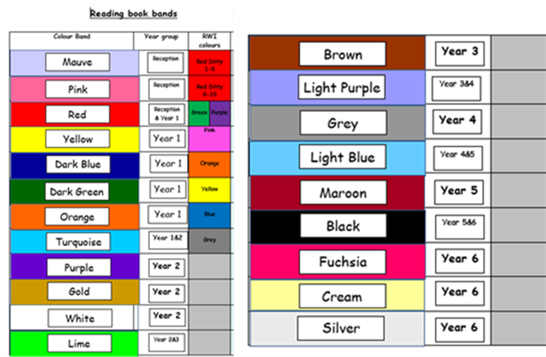
Reading
Children to bring home two books: a banded book and a book for pleasure.
Banded books -matched to their attainment reading level. They will work through a series of banded books and work their way through the year groups banded colours. Throughout the year, the child will be monitored and assessed as to when they can move up to the next level by the class teacher.
Reading for pleasure – This is a book they have chosen to read for their enjoyment. This could range from a comic, magazine, fiction etc.

Slide 17



Supporting Reading at home
Frequency of reading expectations
KS1 – adults need to sign that they have read daily and can write a comment 2/3times a week.
LKS2 – adults needs to sign once a week and child can complete comments for rest of week.
UKS2 – children can write their comments. Adults to do it if possible, but we appreciate it is harder for older children.
Use the questioning prompt at the back of the reading record to support you talking to your child about their book. This will develop key comprehension skills for your child.

Slide 18
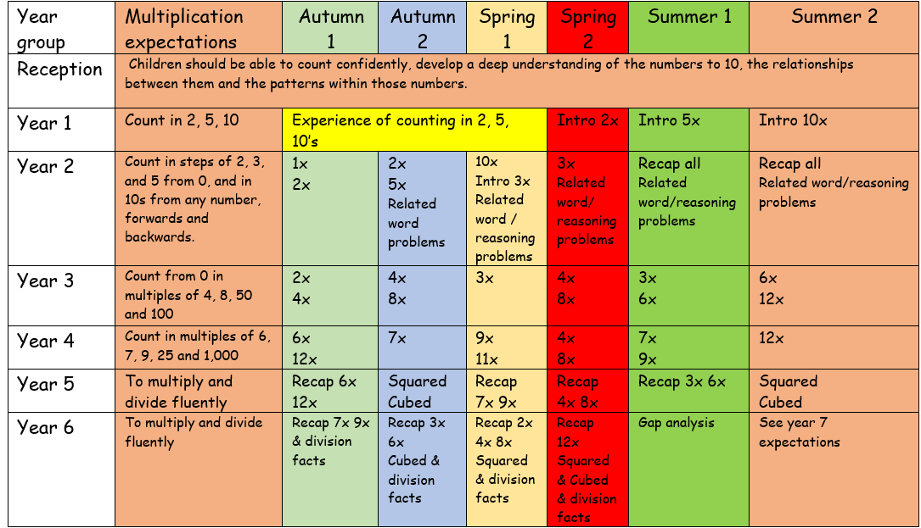
Times Tables

Slide 19
Supporting Times Tables at home
Practise times tables at home by old fashioned chanting
Ask your child times tables questions out of order – such as 11 x 12, then 5x6
Use Apps and games to help build up speed
Times Tables Rock Stars (logins provided)
https://www.timestables.co.uk/speed-test/
https://mathsframe.co.uk/
http://www.timestables.me.uk/

Slide 20
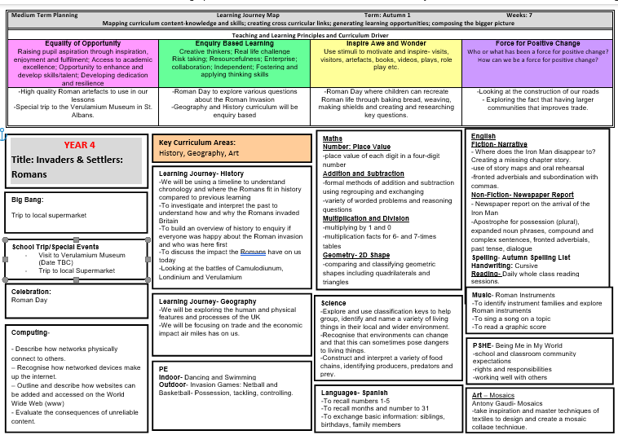
Curriculum

Slide 21

English
Ted Hughes- The Iron Man
Fiction- Narrative about the disappearance of the Iron Man
Non-fiction- Newspaper report about the Iron Man
Year 4 expectations follow on from Year 3

Slide 22
How do I know how well my child is doing?
Children are continually assessed, through questioning and marking, and teachers plan to address gaps in learning or stretch children.
Children will complete formal NFER tests in Autumn 2, Spring 2 and Summer 2
There will be parent consultations in Autumn Term and Spring Term and Reports at the end of Summer Term which will inform parents of your child’s progress and attainment.
However, please come and speak to class teacher should you have any concerns about your child’s attainment during the year.

Slide 23
Trips
This term we will attend:
Roman Britain Interactive Workshop- 24.09.25
GeoBus- 20.10.25
Local Walk

Slide 24

Young Voices 2026

Slide 25

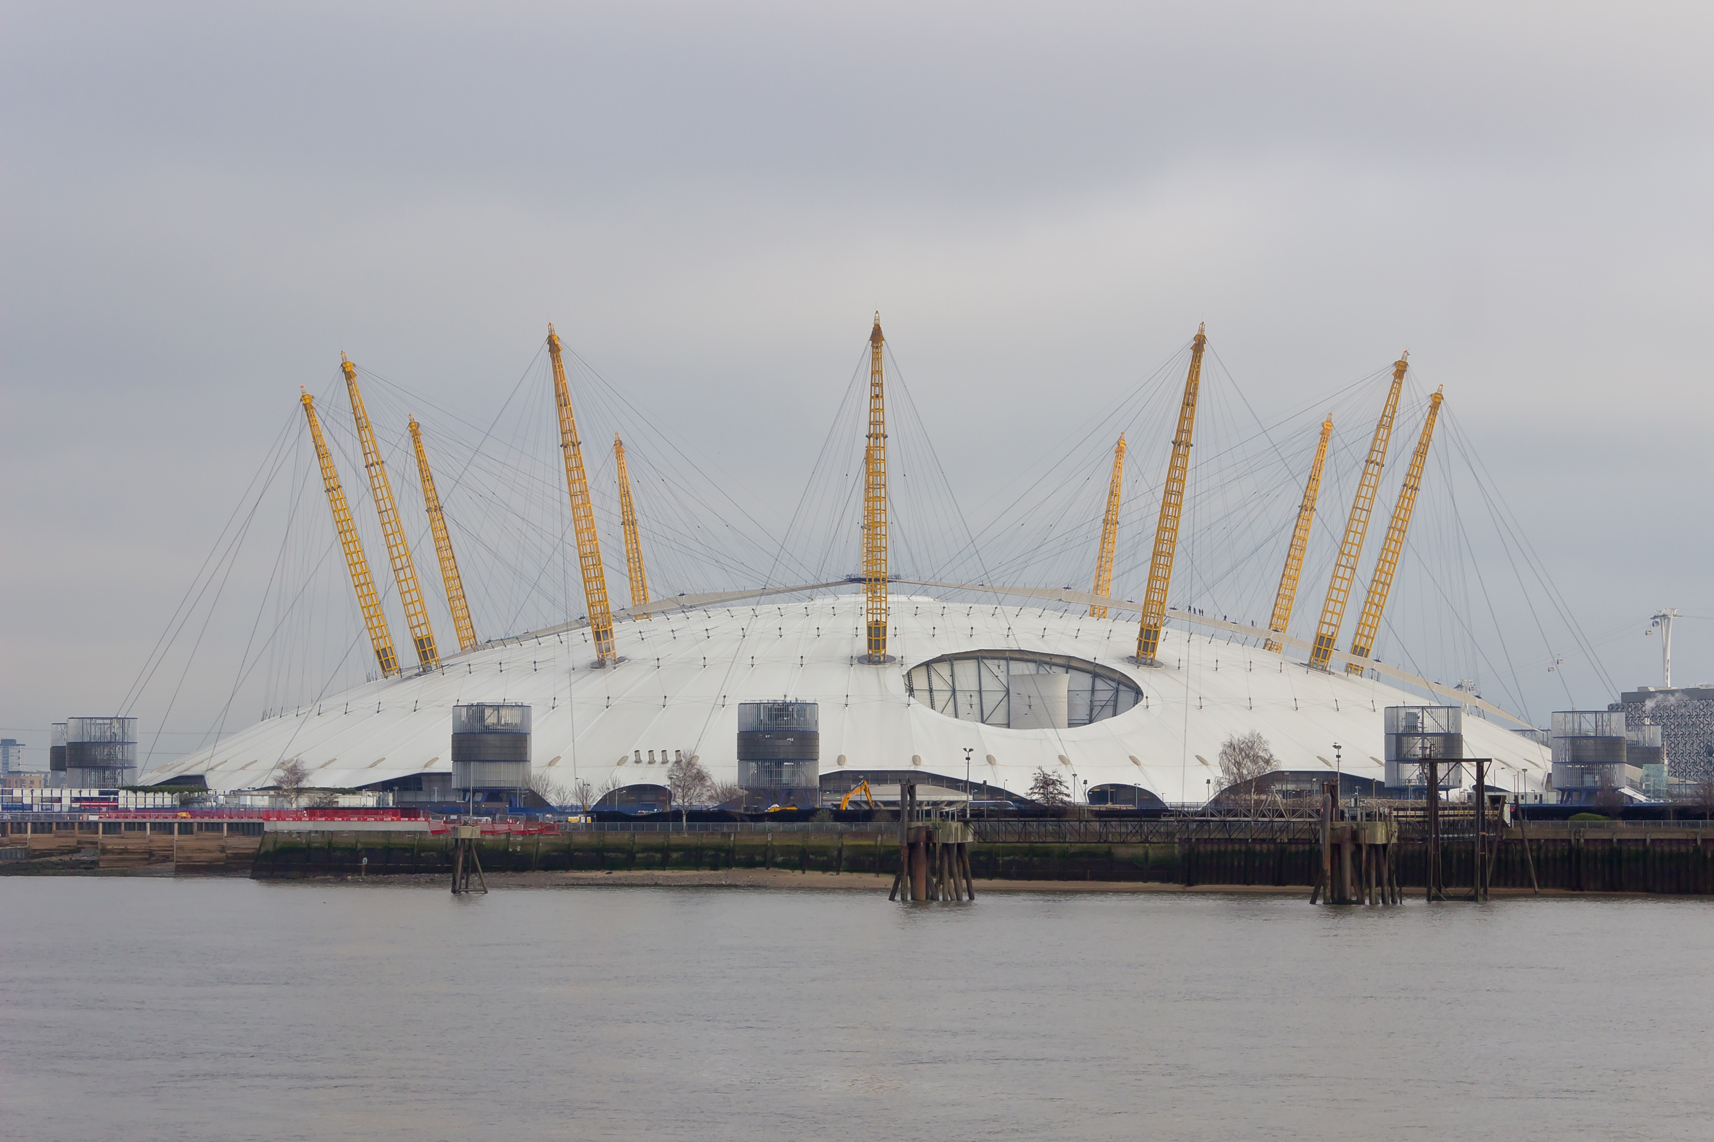
On Wednesday 21st January 2026, Year 4 are invited to take part in a concert at the O2 Arena held by Young Voices, an organisation which runs “the largest school choir concerts in the world”.
The 2026 event will be extra special, being a milestone year for Young Voices as it celebrates its 30th anniversary!
As usual, it is free for our children to take part.

Slide 26
The concert
On the big day, our singers will rehearse as part of a choir of up to 8,000 children from schools across London and the south-east, including our sister primary schools.
In the months leading up to the event, Mr. Okine will be teaching the repertoire of songs written and arranged for the concert.
We will go to and from the venue by coach.

Slide 27

Tickets
For family members interested in attending the concert as an audience member, tickets are available at the cost of £27 per person.
Payment for these will be through Arbor and should be made no later than Friday 26th September. As you can imagine, these events are highly popular so tickets are subject to availability, which is why we’re letting you know now.
If you don’t order tickets through school by this date and still wish to attend then you will have to contact the O2 Arena box office to purchase tickets, if there are any left. Please bear in mind that this option is more expensive due to additional charges.

Slide 28
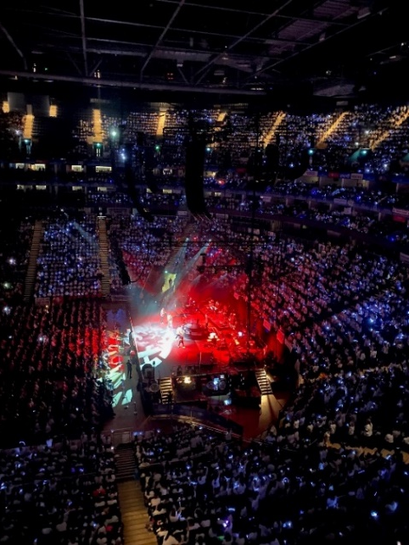
After the concert
Whether you choose to attend the concert or not, the expectation is that your child will be picked up after the concert has finished and they have been brought back to school, which will be at approximately 11pm.
With this in mind, your child may come into school at 10.30am the morning after (Thursday 22nd January).
It is a long day but the sense of achievement and joy from being part of such a great experience will be more than worth it! Check the image from the last event to get a feel for the scale of the event and the excitement that comes with it.

Slide 29


The National Curriculum
The Young Voices experience complements the children’s music learning as, according to the National Curriculum for music…
“Children should be taught to:
play and perform in solo and ensemble contexts, using their voices and playing musical instruments with increasing accuracy, fluency, control and expression
appreciate and understand a wide range of high-quality live and recorded music drawn from different traditions and from great composers and musicians”

Slide 30


Previous guest performers

Slide 31

Last year’s guest performers
MC Grammar
Tommy Blaize
Souparnika Nair

Slide 32
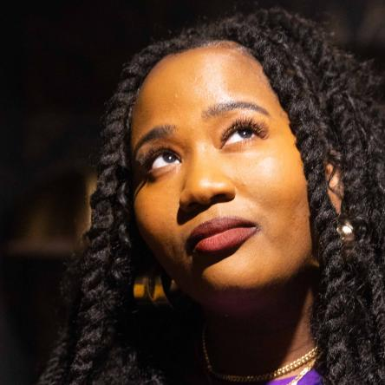
This year’s headline performer (more TBA)
Aneesa Folds (American Young Voices)
Meet Aneesa here

Slide 33
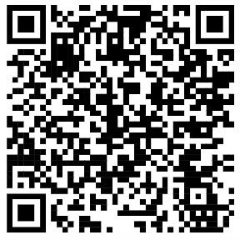

Spotify playlist
For those of you that have Spotify, if you scan this QR code, it will take you to a playlist of the songs that the children will be learning for January’s Young Voices event.

Slide 34

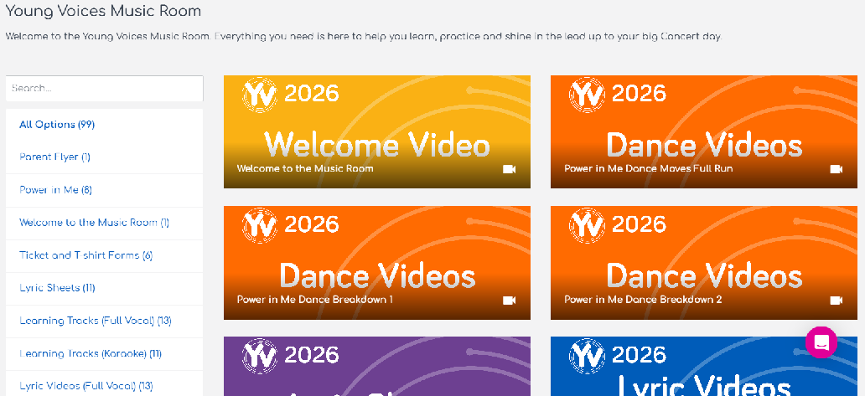

YV Music Room
You will soon receive a letter with additional information about the event.
In the letter, there will be a link to sign up for the YV Music Room. This will give you access to learning tracks and lyric videos, so your child can practise at home as well as school. It will also give you access to the YV shop.
Scan the QR code below to sign up now:

Slide 35
What should I do if you have any questions or concerns?
We are always available to hear your concerns and strive to resolve them in good time. We kindly ask that you follow the following pathway of communication:
Pass any information that could be relevant for the day (office/member of staff at the gate, teacher)
Address class team first; request appointment
Speak to Mrs Salik (Year 1,2, 3 Teaching and Learning Lead) or Mr Currie (Year 4,5,6 Teaching and Learning Lead)
Request a meeting with DHT Mr Venn (contact office)
If you are still concerned and situation has not been resolved, request an appointment with HT Mrs Powrie
SEN concerns-Mrs Moore, Inclusion and SEND Lead (working on Mondays, Tuesdays and Thursdays)
SEND concerns could also be directed via the following email: eha-senco@northstartrust.org.uk; FAO Mrs Moore

Slide 36
Key dates
PE days – Tuesday (Outdoor PE with Mr Brown) Monday (Indoor PE with Mrs. Ubor)
Homework days: Sent out Friday, due back in on Tuesdays
Pupils are expected to read everyday. Books changed upon completion of banded text
Music lessons. Music lesson with Mr Okine Tuesday
Trips
Parent consultation day: Thursday 17th October
Workshops –
Roman Britain Virtual Workshop 24.09.25
Geo Bus 20.09.25

Slide 37




PTA- EHA needs you!
CALLING ALL PARENTS & CARERS!
WE NEED YOUR HELP!
Are you interested in becoming a member of Parent Teacher Association?
Please help us raise more funds for EHA.
We need you to help spread the word and drum up support for the events run by our Parent Teacher Association throughout the year.
Let your class teacher know if you would like to volunteer!

Slide 38

Thank you
Any Questions?

